Slide 1

MS SQL 2012 Database Administration Training by Sholla Corporation
8204 Fenton Street
Silver Spring, MD 20910

Slide 2
Course Topics
Administering SQL Server 2012 Jump Start
01 | Install and Configure SQL Server | 04 | Manage Data
02 | Maintain Instances and Databases | 05 | Implement Security
03 | Performance Optimization and Troubleshooting | 06 | High Availability Options

Slide 3
Setting Expectations
Target Audience
Database professionals new to Microsoft SQL Server
“Accidental DBAs” and new database professionals
Database professionals who want to take exam 70-462 to get certified in administering Microsoft SQL Server 2012 databases
Suggested Prerequisites/Supporting Material
Basic familiarity with Microsoft SQL Server and relational databases
Windows Server user interface and administration experience
MS Press Book: Training Kit (Exam 70-462): Administering Microsoft SQL Server 2012 Databases

Slide 4
Module 1 Overview
Installation Decisions
Design the Storage for New Databases
Plan for Growth and Capacity
Service Account Configuration

Slide 5


Topic: Installation Decisions
Determine the Appropriate Hardware
Select the Appropriate Windows Operating System Edition
Select the Appropriate Edition of SQL Server
Determine if a Separate Instance Is Required
Select the Appropriate Collation

Slide 6
Determine the Appropriate Hardware
To virtualize or not to virtualize?
CPU sockets and cores
Memory
Memory support is a function of the Windows operating system or the chosen edition
DAS versus SAN
Consider solid state storage
Free, unsupported tools are available to help test I/O workloads:
SQLIO “disk subsystem benchmark tool”
SQLIOSIM

Slide 7
Select the Appropriate Windows Operating System Edition
Specific editions of SQL Server are supported on specific versions and editions of Windows Client and Windows Server
One way or another, the following operating systems are supported:
Windows Server 2012
Windows Server 2008 R2 and Windows Server 2008 SP2
Windows Vista, Windows 7, and Windows 8
SQL Server 2012 is supported on Windows Server 2012 core and Windows Server 2008 R2 core
No need to memorize all the combinations for the certification exam

Slide 8
Select the Appropriate Edition of SQL Server 2012
Editions to choose from are:
Principal Editions
Enterprise
Business Intelligence
Standard
Evaluation
Specialized Edition(s)
Web
Breadth Editions
Express
Developer

Slide 9
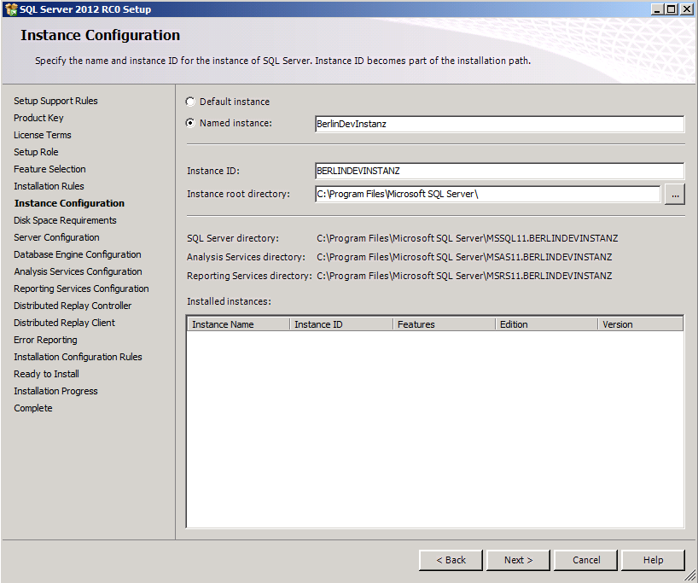
Determine if a Separate Instance Is Required
Each instance will have its own set of services and service settings
Separate administration requirements
Separate instance-level configuration settings
Separate SLAs
Support for separate collations
Support for multiple versions of SQL Server
Know which features can be installed as instances

Slide 10
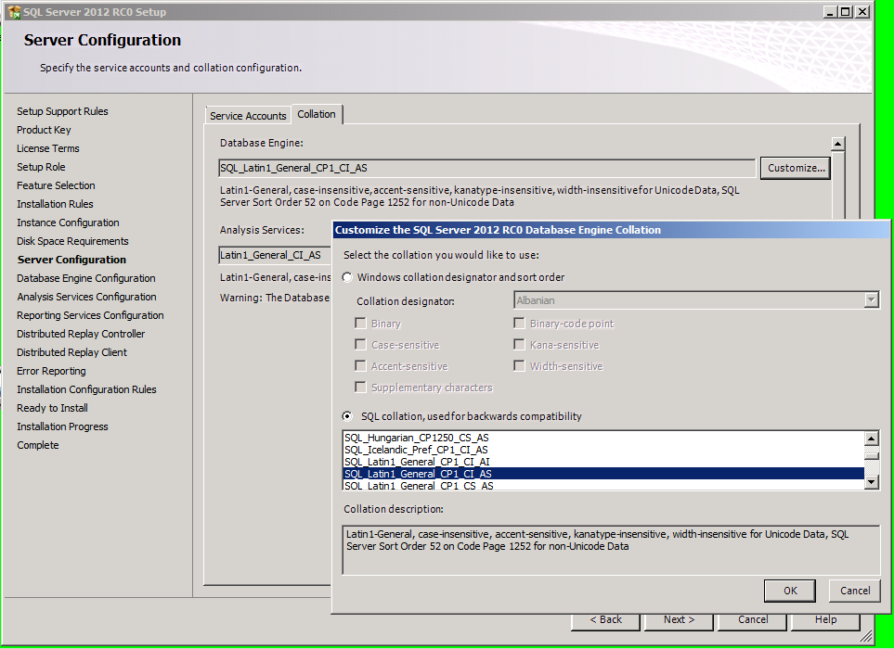
Select the Appropriate Collation
What is a collation?
What is the impact of collation choice during installation?
Where can collation be specified?

Slide 11
DEMO
Specifying Collation at the Instance, Database, Column and Query Levels

Slide 12
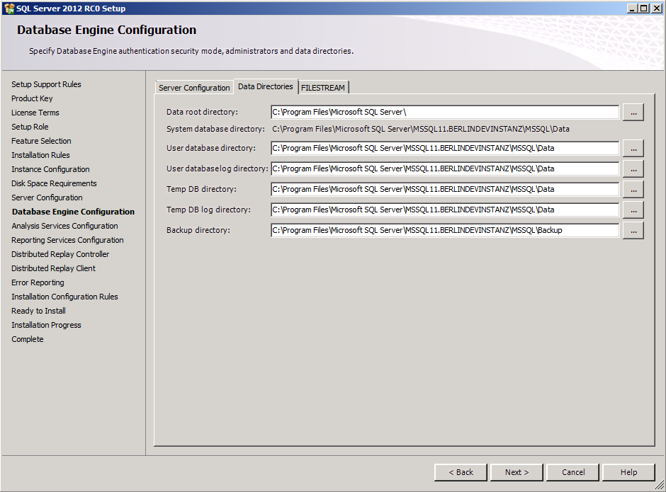
Topic: Design the Storage for New Databases
Drive Layout: Design Windows File System for Expected I/O Patterns
Consider Multiple Filegroup and Multiple Data File Designs
Table Partitioning Design

Slide 13
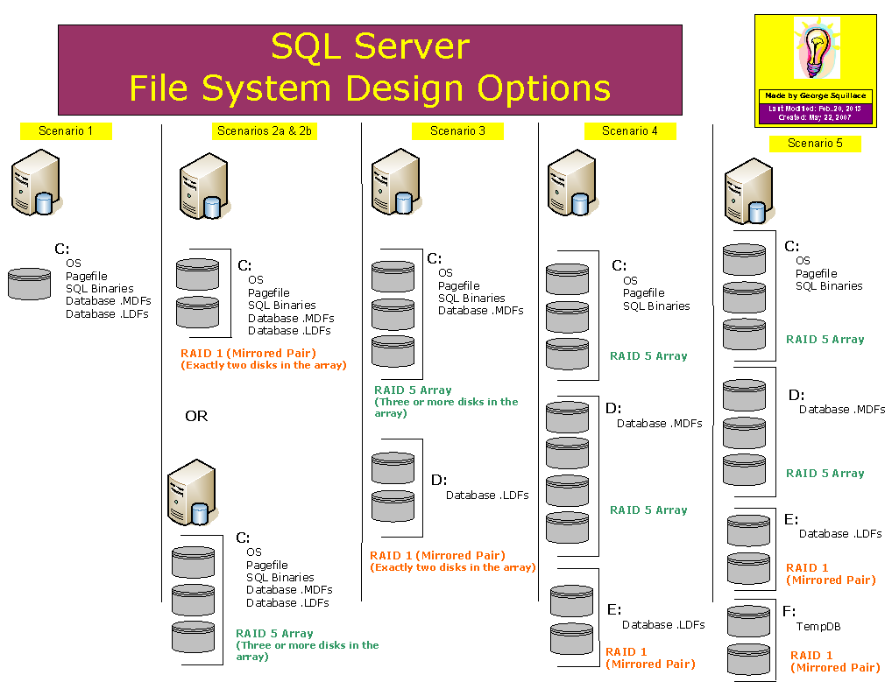
Drive Layout: Design Windows File System for Expected I/O Patterns
Separate I/O activity on systems with heavy workloads:
OS vs. data file(s) vs. log file
Consider separating TempDB workload
Consider adding multiple data files to TempDB
Use appropriate RAID levels and parity when appropriate
Consider adding multiple data files to TempDB for large workloads

Slide 14
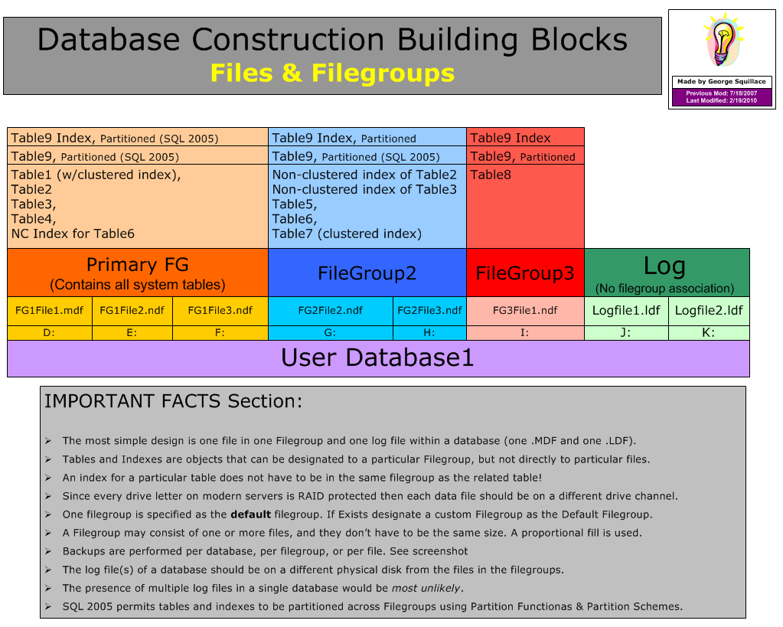
Consider Multiple Filegroup and Multiple Data File Designs
Use this advanced design technique for two reasons:
Performance
More read/write heads involved in reading and writing
Maintenance
Smaller units of data backed up/restored, indexes reorganized/rebuilt

Slide 15
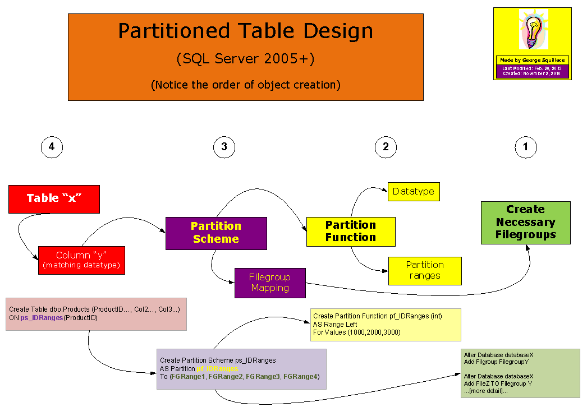
Table Partitioning Design
Table partitioning spreads the data of a single table over multiple filegroups
Purpose
Use more read/write heads to separate I/O activity over separate partitions
Efficiently load new data into a (large) table
Perform index maintenance on a partition by partition basis
Concept of index “alignment”
References
Designing Partitions to Manage Subsets of Data
SlidingWindow example

Slide 16
DEMO
Creating a Database with an Advanced Design

Slide 17
Topic: Plan for Growth and Capacity
Two DBA Cardinal Sins
Manual File Growth
File Autogrow Options
Growth Monitoring
Shrinking Databases and Files

Slide 18
Two DBA Cardinal Sins
Running out of space in a SQL Server data or log file
Allowing a data or log file to fill up a volume when autogrow is used

Slide 19
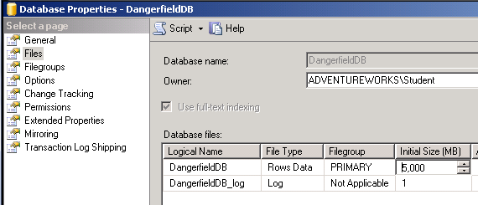
Manual File Growth
Why manual?
Timing and control
Methods
GUI
Code

Slide 20
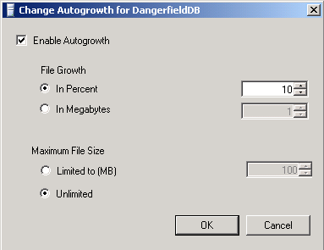
File Autogrow Options
Why autogrow?
Percent vs. fixed size
Should “maximum file size” be set?
Methods
GUI
Code

Slide 21
Growth Monitoring
If/when to shrink or grow
Monitoring tools and techniques
Code in agent jobs
Performance object alert
Management Data Warehouse
Catalogs and DMVs
sys.database_files
sys.dm_os_volume_stats
Stored procedures
sp_SpaceUsed
sp_Databases
DBCC SQLPerf (logspace)

Slide 22
Shrinking Databases and Files
Databases (all files) can be shrunk
Individual data and log files can be shrunk
Autoshrink can be set as a database option
Just say “No”
Turned off by default
Manual shrinking only relevant in one context

Slide 23
DEMO
Growing File Size Manually Using the GUI and Code

Slide 24
Topic: Service Account Configuration
Account Selection During Installation
Changing Account Choices After Installation
Which tool? Why that tool?
On What Basis Do I Select Accounts to Run Services?

Slide 25
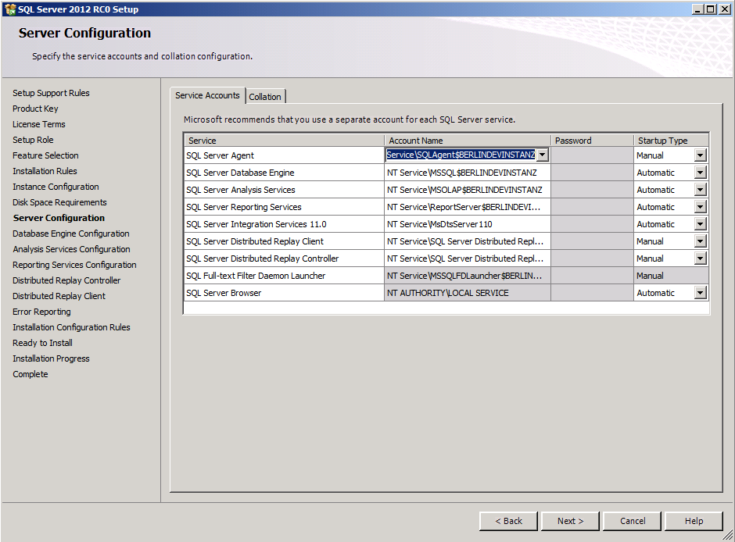
Account Selection During Installation
Builtin Account
Local Service
Network Service
Local System
Created Account
Machine Local
Domain
General rule: create a separate account for each service, for each instance…really!

Slide 26
Changing Account Choices After Installation
Use SQL Server Configuration Manager
Don’t use the Services management console in Windows

Slide 27
On What Basis Do I Select Accounts to Run Services?
Database engine can use a low-privileged account
Browser and Full-Text Services shouldn’t require a domain account either
SQL Server Agent may need access to:
Mailbox
UNC shares and file systems
Other SQL Servers
Reference: Configure Windows Service Accounts and Permissions

Slide 28
DEMO
Changing Service Account Assignment

